Slide 1
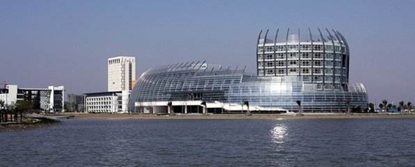
Maximum Channel Access Probability Based on Post-Disaster Ground Terminal Distribution Density
Xingxing Hu
Donghua University, Shanghai, China
2181295@mail.dhu.edu.cn

Slide 2
CONTENTS
Background
Problem & challenge
Contributions
System Model
Problem formulation & analysis
Simulation analysis
Conclusion
2

Slide 3
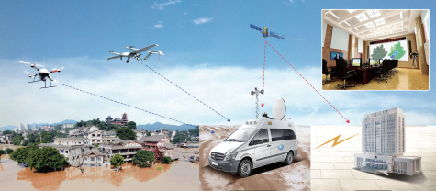
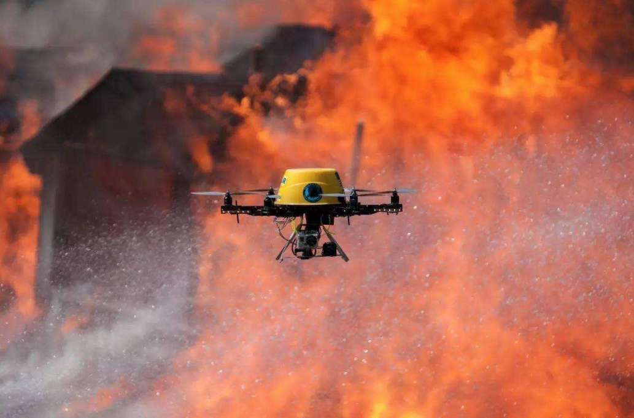
Background
After the disaster, the ground communication infrastructure will be severely damaged, which will bring great troubles to rescue work.
Due to its lightness, compactness, flexible layout and high probability of line-of-sight transmission, UAVs have been widely used in post-disaster rescue work.
Aerial BS, relay, information dissemination and data collection.
3

Slide 4
Problem & Challenge
The impact levels in the whole post-disaster area maybe different. We should use a suitable distribution to model the location of ground terminal (GT) according to GTs’ distribution densities.
UAV’s speed should be adjusted according to GTs’ distribution densities.
A dynamic channel resource schedule should be made to further improve channel access probability.
4

Slide 5
Contributions
A more suitable Thomas cluster process (TCP) rather than Poisson point process (PPP) is used to model the locations of GTs and each cluster has different GT distribution density.
We propose an UAV adaptive speed cruise model based on GT distribution density among the whole disaster area.
An efficient channel schedule method is proposed to alleviate resource competition.
5

Slide 6
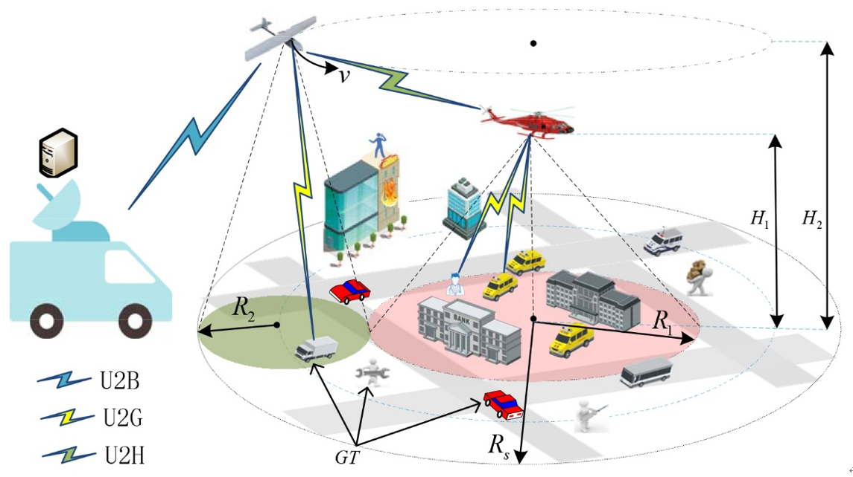
System Model -- Network Structure
A hover flying helicopter (HFH) is deployed to cover the worst heavily hit area. The cruise flying UAV circles around HFH. The coverage of HFH and UAV is neither overlap nor gap.
The coverage radius of HFH and UAV are
and the corresponding flying heights are
There are many GTs in the ground of post-disaster area and all GTs are equipped with battery powered transceivers. GTs located in different area could communicate with corresponding aircrafts.
6

Slide 7
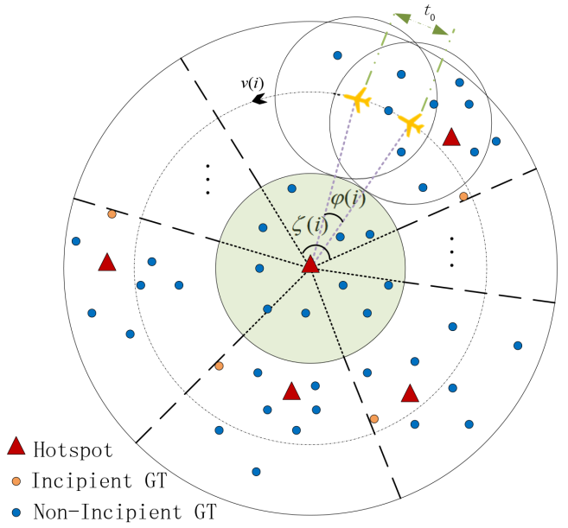
System Model -- GT Distribution
The locations of hotspots, such as densely populated areas, are modeled by an independent PPP .
The locations of all GTs who are scattered around hotspots are modeled by TCP.
When UAV flies over subregion , the speed of UAV is .
7

Slide 8
System Model -- Channel Model
We consider the Air-to-Ground channel which is dominated by Light-of-Sight link:
Channel power gain
Small scale fading
Distance from GT to the horizontal projection point of its corresponding aircraft
Flying height of HFH or UAV
8

Slide 9
System Model -- Cruise Model
We introduce the channel access delay (seconds) which indicates the minimum time for establishing a complete communication link with the UAV is .
UAV will adjust its speed according to the GT distribution density among the whole post-disaster area. So, UAV has different optimal speed when flying through different subregion.
The UAV is fixed-wing and it needs a minimum speed to maintain its aloft.

Slide 10
Problem formulation
Channel SNR threshold probability:
It is defined as the probability that a random GT satisfies the SNR condition when it picks up the detection signal sent by its corresponding aircraft.
Aircraft’s transmission power
SNR threshold
Noise power

Slide 11
Problem formulation
Channel schedule :
It denotes the percentage of channels obtained by HFH when the UAV flies over subregion
Average number of GTs under HFH coverage area
GT distribution density of cluster
Overlapping area within when UAV flies over the sector ring

Slide 12
Problem formulation
Cruise efficiency:
Maximum cruise cycle
The required time that UAV flies past subregion

Slide 13
Problem formulation
Channel access probability of subregion :
Probability that any GT under UAV coverage can connect to UAV
Probability that any GT under HFH coverage can connect to HFH

Slide 14
Problem formulation
Objective function:
Our goal is to obtain the maximum channel access probability by optimizing the flight speed of UAV.

Slide 15
Problem analysis
It is easy to prove that the constraints are all convex.
Through scaling and Taylor expansion, we can prove that the objective function is also convex.
By using the standard convex optimization algorithm, we can get the optimal solution to the problem.

Slide 16
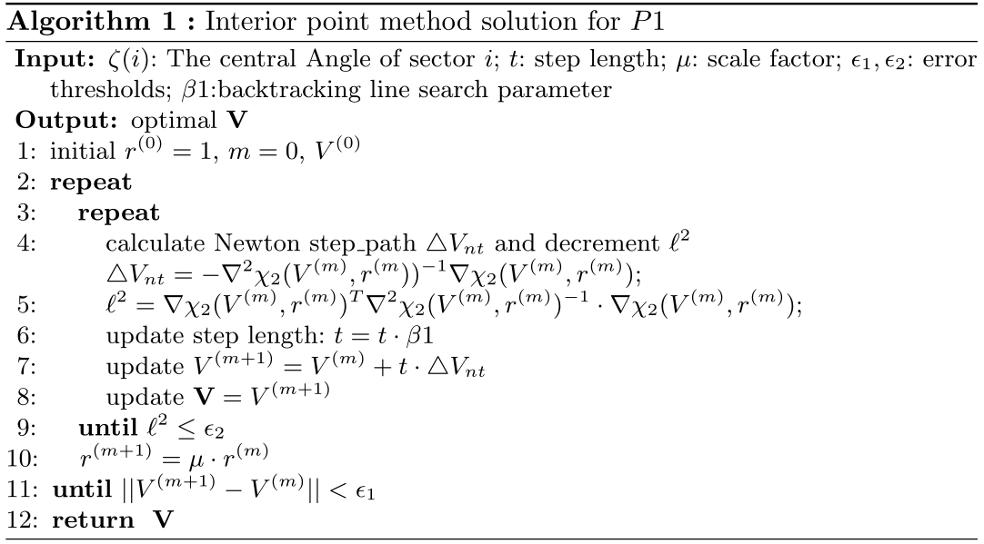
Interior point method

Slide 17
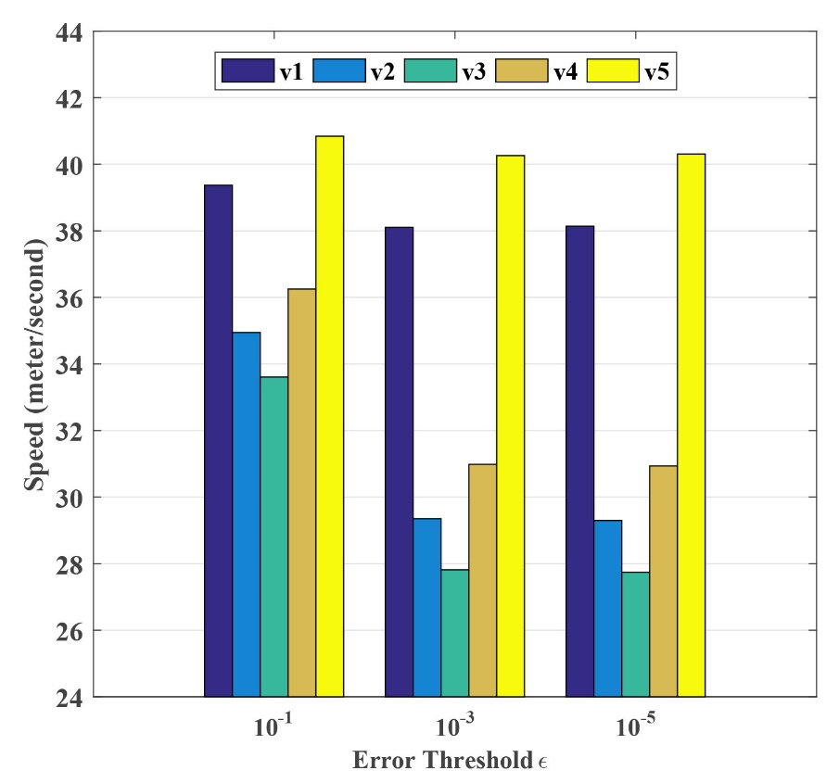
Simulation analysis
The optimal speed of the drone under different errors
17

Slide 18
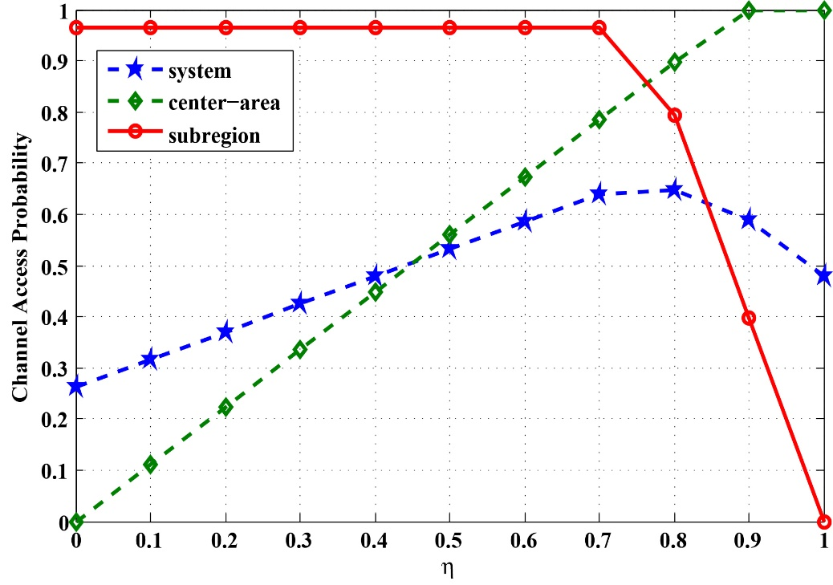
Simulation analysis
Comparison of system channel access probability under different channel schedule
18

Slide 19
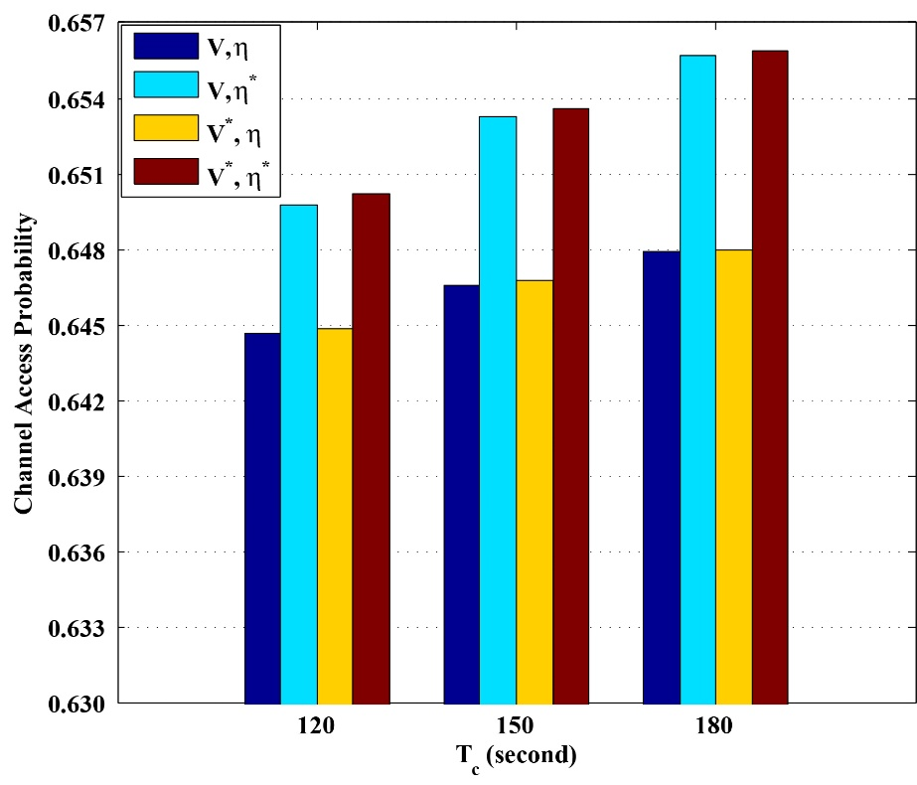
Simulation analysis
Channel access probability under different optimization conditions
19

Slide 20
Conclusions
First, channel access probability can be improved by adopting a dynamic channel schedule and optimizing the UAV speed of each subregion.
Second, compared with constant UAV speed or channel schedule, the simulation results reveal that the proposed method performances well in channel access probability and achievable rate.
20

Slide 21
Future work
In future research, we will pay more attention to the cooperative flight of multiple UAVs, including the research of FANET's communication routing protocol, the collaborative trajectory of multiple drones and energy optimization.
In future research, we will perform field simulations in various scenarios.

Slide 22
Thanks!
College of Information Science and Technology
Donahue University, Shanghai, China

